Slide 1

Netflix Data Analysis
Presented by:
Geetha Potuka

Slide 2
Netflix Dataset-Column Summary
The netflix_DATA table holds Netflix titles with key details. It includes show_id, type (Movie or TV Show), title, director, cast, and country. date_added and release_year indicate when content was added and released. rating and rating_age show age restrictions. duration and duration_mins represent runtime, while listed_in highlights genres. description provides a brief summary of each title.

Slide 3

1.Total Number of Records in the Dataset
Code:
select count(*) as total_rows from netflix_data;

Slide 4
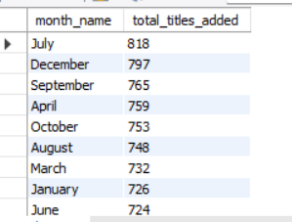
2. Content Upload Frequency by Month
Code:
SELECT MONTHNAME(STR_TO_DATE(date_added, '%m/%d/%Y')) AS month_name, COUNT(*) AS total_titles_added FROM netflix_data WHERE date_added IS NOT NULL AND date_added != ''GROUP BY month_name ORDER BY total_titles_added DESC;

Slide 5
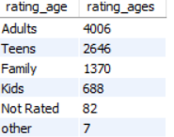
3.Content Classification by Age Rating
Code:
select rating_age,count(*) as rating_ages from netflix_data group by rating_age order by rating_ages desc;

Slide 6

4. Number of Titles per Director
Code:
SELECT director, COUNT(*) AS total_titles FROM netflix_data WHERE director IS NOT NULL AND director != ‘’ GROUP BY director ORDER BY total_titles DESC;

Slide 7

5. Movies vs. TV Shows: Title Counts
Code:
select type,count(type) as total_count from netflix_data group by type;

Slide 8
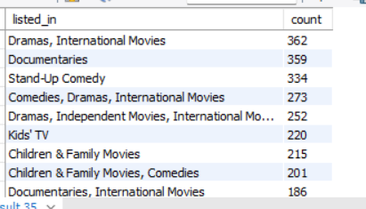
6. Top 10 Most Frequent Genres
Code:
select listed_in,count(*) as count from netflix_data group by listed_in order by count desc limit 10;

Slide 9
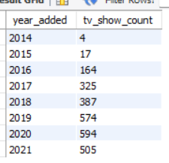
7. Number of Shows Added Each Year
SELECT EXTRACT(YEAR FROM STR_TO_DATE(date_added, '%m/%d/%Y')) AS year_added, COUNT(*) AS tv_show_count FROM netflix_data WHERE type = 'TV Show' AND date_added IS NOT NULL GROUP BY year_added ORDER BY year_added;

Slide 10

8. TV Show with the Highest Number of Seasons
Code:
SELECT title, duration FROM netflix_data WHERE type = 'TV Show' AND duration IS NOT NULL ORDER BY CAST(SUBSTRING_INDEX(duration, ' ', 1) AS UNSIGNED) DESC LIMIT 1;

